Slide 1
HTML + CSS Session
Basant Mohamed

Slide 2
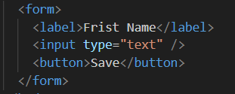

Form
An HTML form is used to collect user input. The user input is most often sent to a server for processing.
Form Elements : The HTML <form> element can contain one or more of the following form elements <input> , <label> , <select> ,<button> ,<textarea> ,<fieldset>,<legend> ,<datalist>,<output>,<option>,<optgroup>

Slide 3
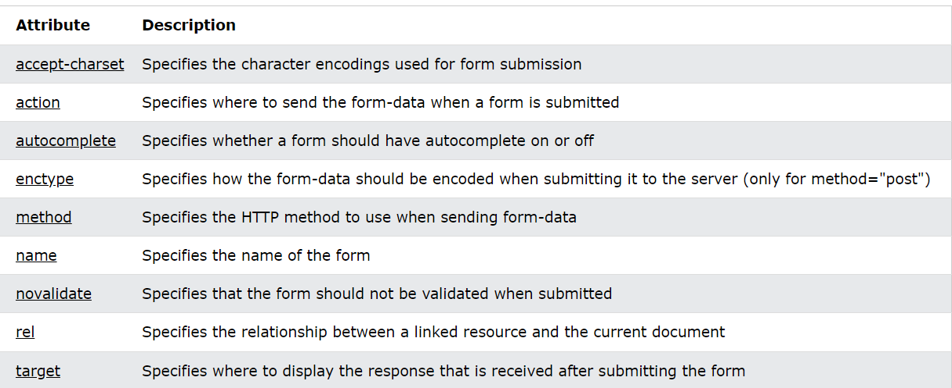
Form attributes
The action attribute defines the action to be performed when the form is submitted.
The autocomplete attribute specifies whether a form should have autocomplete on or off.

Slide 4
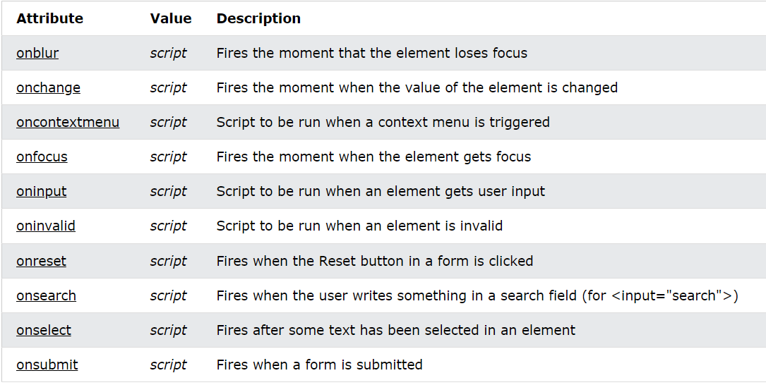
Form events

Slide 5
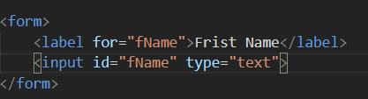
Form Label
Defines a label for several form elements.
For : The for attribute specifies which form element a label is bound to.

Slide 6
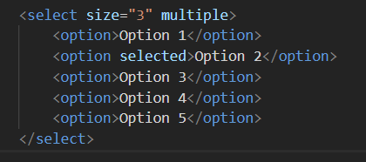

Form select
Form select attributes
The <select> element defines a drop-down list
The <option> elements defines an option that can be selected.
By default, the first item in the drop-down list is selected.
To define a pre-selected option, add the selected attribute to the option
Use the size attribute to specify the number of visible values
Use the multiple attribute to allow the user to select more than one value

Slide 7
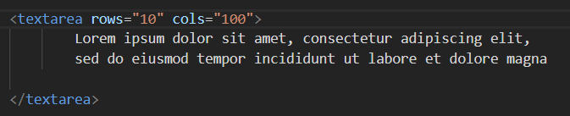
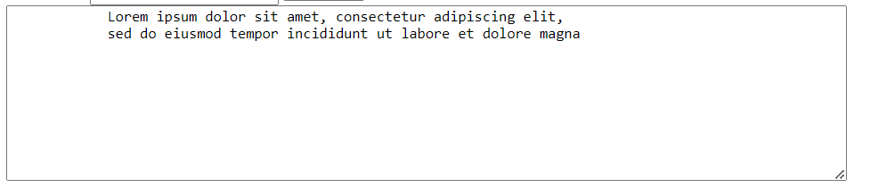
Form textarea
The <textarea> element defines a multi-line input field (a text area)
The rows attribute specifies the visible number of lines in a text area.
The cols attribute specifies the visible width of a text area.

Slide 8
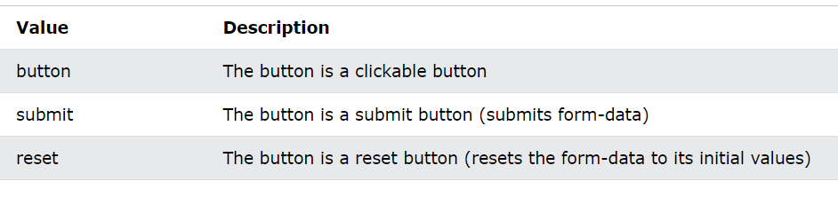
Form Button

Slide 9
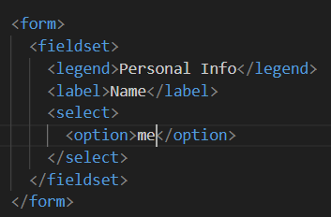
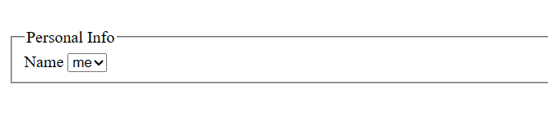
Form fieldset and legend
The <fieldset> element is used to group related data in a form.
The <legend> element defines a caption for the <fieldset> element.

Slide 10
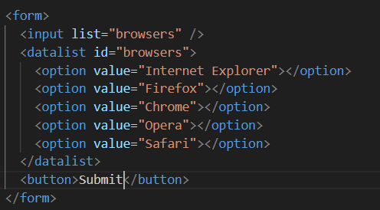
Form datalist
The <datalist> element specifies a list of pre-defined options for an <input> element.
Users will see a drop-down list of the pre-defined options as they input data.
The list attribute of the <input> element, must refer to the id attribute of the <datalist> element.

Slide 11
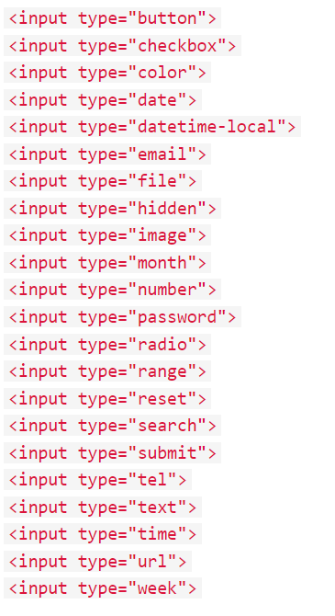
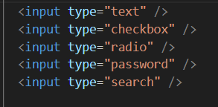
Input Type attribute
There are different types of inputs :

Slide 12
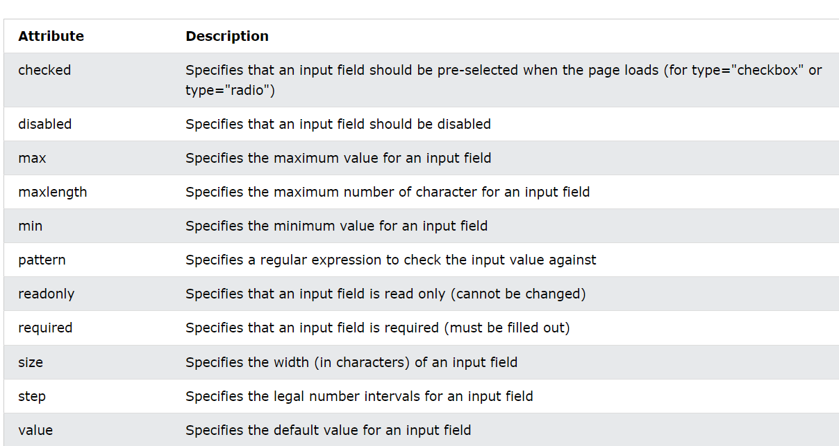
Inputs Restrictions

Slide 13
Input Attributes
The input value attribute specifies an initial value for an input field
The input readonly attribute specifies that an input field is read-only
The input disabled attribute specifies that an input field should be disabled
The input size attribute specifies the visible width, in characters, of an input field.The default value for size is 20 ,it works with text, search, tel, url, email, and password
The input maxlength attribute specifies the maximum number of characters allowed in an input field.
The input min and max attributes specify the minimum and maximum values for an input field ,works with number, range, date, datetime-local, month, time and week
The input placeholder attribute specifies a short hint that describes the expected value of an input field
The input required attribute specifies that an input field must be filled out before submitting the form.
The input step attribute specifies the legal number intervals for an input field

Slide 14

Any Question ????

Slide 15
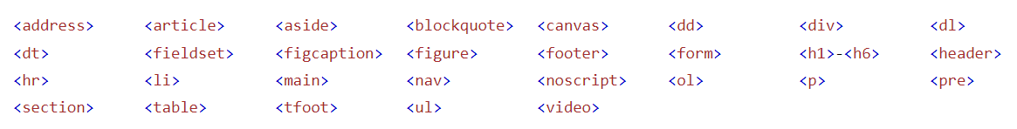
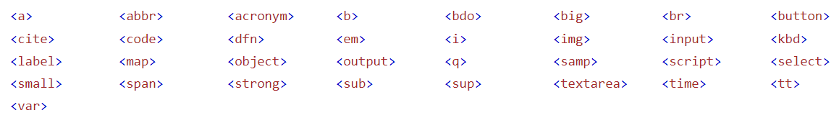
Block and Inline Elements
A block-level element always starts on a new line, and the browsers automatically add some space (a margin) before and after the element.
An inline element does not start on a new line.

Slide 16
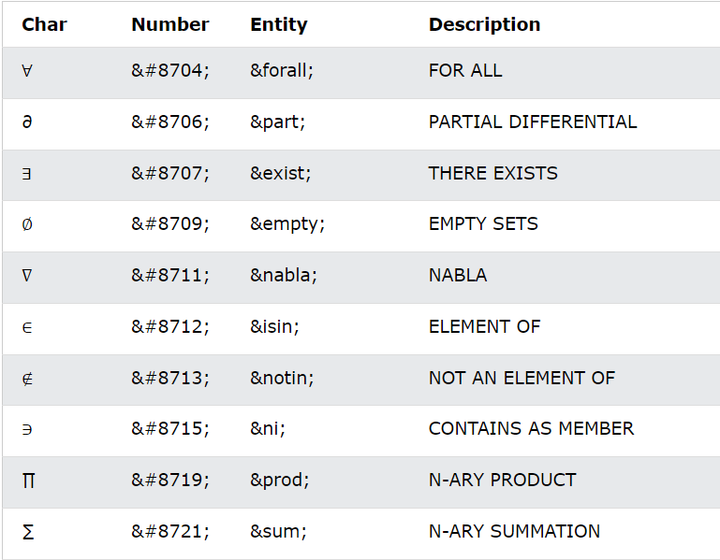
HTML Symbols

Slide 17
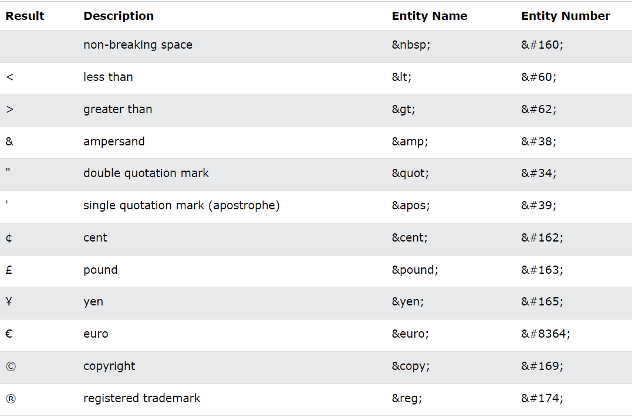
HTML Entity

Slide 18
Any Question ????

Slide 19
HTML style
The HTML style attribute is used to add styles to an element, such as color, font, size, and more.
<tagname style="property:value;">
background-color for background color
color for text colors
font-family for text fonts
font-size for text sizes
text-align for text alignment
Note : This Style called inline CSS is used to apply a unique style to a single HTML element.

Slide 20
What is CSS?
CSS is the language we use to style a Web page.
CSS stands for Cascading Style Sheets
CSS describes how HTML elements are to be displayed on screen, paper, or in other media
CSS saves a lot of work. It can control the layout of multiple web pages all at once
External stylesheets are stored in CSS files

Slide 21
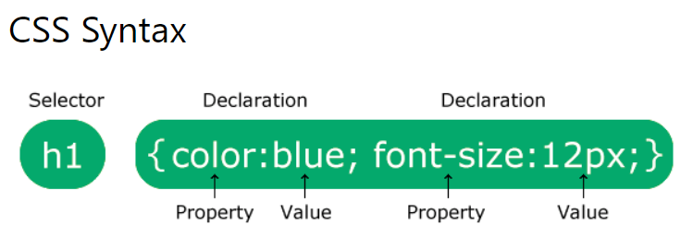
CSS Syntax
The selector points to the HTML element you want to style.
The declaration block contains one or more declarations separated by semicolons.
Each declaration includes a CSS property name and a value, separated by a colon.
Multiple CSS declarations are separated with semicolons, and declaration blocks are surrounded by curly braces.

Slide 22
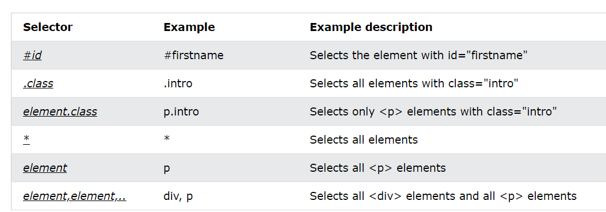
CSS Selector
CSS selectors are used to "find" (or select) the HTML elements you want to style.

Slide 23
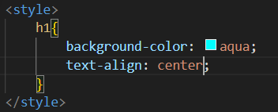
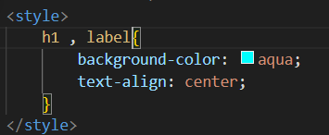
Element Selector
The element selector selects HTML elements based on the element name.

Slide 24
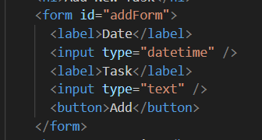

Id Selector
The id selector uses the id attribute of an HTML element to select a specific element.
The id of an element is unique within a page, so the id selector is used to select one unique element!

Slide 25
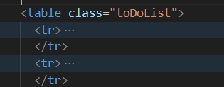
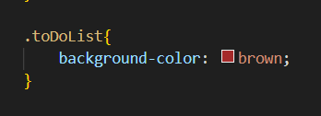
Class Selector
The class selector selects HTML elements with a specific class attribute.
To select elements with a specific class, write a period (.) character, followed by the class name.

Slide 26
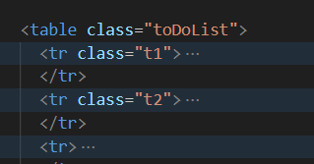
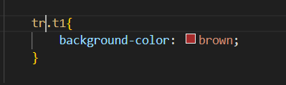
Element with class selector
You can also specify that only specific HTML elements should be affected by a class.

Slide 27
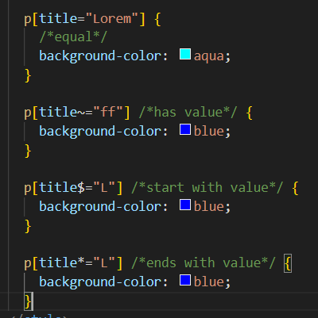
Attr Selector
The [attribute] selector is used to select elements with a specified attribute.

Slide 28

Universal Selector
The universal selector (*) selects all HTML elements on the page.

Slide 29

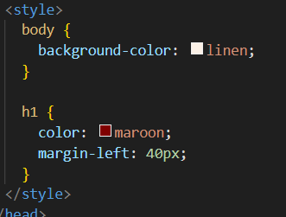
How To Add CSS?
External CSS :
Internal CSS :
Inline CSS :

Slide 30
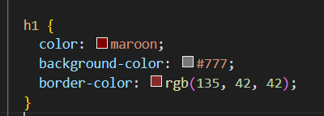
CSS Color:
CSS Background :
Background-color
Background-image : url(‘image.png’)
Background-repeat :no-repeat
Background-attachment : (scroll ,fixed)
Background-position : top right
Background : #ffffff url("img_tree.png") no-repeat right top;

Slide 31
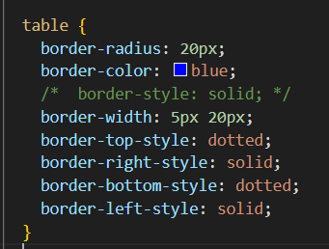
CSS Border
The CSS border properties allow you to specify the style, width, and color of an element's border.

Slide 32
CSS Margin
Margins are used to create space around elements, outside of any defined borders.
Margin-top : 20px
Margin-right : auto
Margin-bottom : inherit
Margin-left : 30%
Margin : top right bottom left

Slide 33
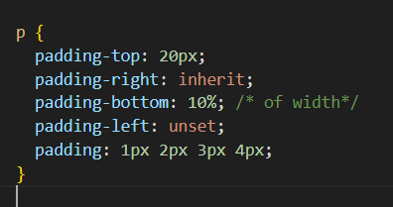
CSS Padding
Padding is used to create space around an element's content, inside of any defined borders.

Slide 34
CSS Height and Width
The CSS height and width properties are used to set the height and width of an element.
The CSS max-width property is used to set the maximum width of an element.
The height and width properties do not include padding, borders, or margins. It sets the height/width of the area inside the padding, border, and margin of the element.
The height and width properties may have the following values:
auto - This is default. The browser calculates the height and width
length - Defines the height/width in px, cm, etc.
% - Defines the height/width in percent of the containing block
initial - Sets the height/width to its default value
inherit - The height/width will be inherited from its parent value

Slide 35
CSS Box Model
Margin
Border
Padding
Content

Slide 36
HTML style
The HTML style attribute is used to add styles to an element, such as color, font, size, and more.
<tagname style="property:value;">
background-color for background color
color for text colors
font-family for text fonts
font-size for text sizes
text-align for text alignment
Note : This Style called inline CSS is used to apply a unique style to a single HTML element.

Slide 37
What is CSS?
CSS is the language we use to style a Web page.
CSS stands for Cascading Style Sheets
CSS describes how HTML elements are to be displayed on screen, paper, or in other media
CSS saves a lot of work. It can control the layout of multiple web pages all at once
External stylesheets are stored in CSS files

Slide 38
CSS Syntax
The selector points to the HTML element you want to style.
The declaration block contains one or more declarations separated by semicolons.
Each declaration includes a CSS property name and a value, separated by a colon.
Multiple CSS declarations are separated with semicolons, and declaration blocks are surrounded by curly braces.

Slide 39
CSS Selector
CSS selectors are used to "find" (or select) the HTML elements you want to style.

Slide 40
Element Selector
The element selector selects HTML elements based on the element name.

Slide 41
Id Selector
The id selector uses the id attribute of an HTML element to select a specific element.
The id of an element is unique within a page, so the id selector is used to select one unique element!

Slide 42
Class Selector
The class selector selects HTML elements with a specific class attribute.
To select elements with a specific class, write a period (.) character, followed by the class name.

Slide 43
Element with class selector
You can also specify that only specific HTML elements should be affected by a class.

Slide 44
Attr Selector
The [attribute] selector is used to select elements with a specified attribute.

Slide 45
Universal Selector
The universal selector (*) selects all HTML elements on the page.

Slide 46
How To Add CSS?
External CSS :
Internal CSS :
Inline CSS :

Slide 47
CSS Color:
CSS Background :
Background-color
Background-image : url(‘image.png’)
Background-repeat :no-repeat
Background-attachment : (scroll ,fixed)
Background-position : top right
Background : #ffffff url("img_tree.png") no-repeat right top;

Slide 48
CSS Border
The CSS border properties allow you to specify the style, width, and color of an element's border.

Slide 49
CSS Margin
Margins are used to create space around elements, outside of any defined borders.
Margin-top : 20px
Margin-right : auto
Margin-bottom : inherit
Margin-left : 30%
Margin : top right bottom left

Slide 50
CSS Padding
Padding is used to create space around an element's content, inside of any defined borders.

Slide 51
CSS Height and Width
The CSS height and width properties are used to set the height and width of an element.
The CSS max-width property is used to set the maximum width of an element.
The height and width properties do not include padding, borders, or margins. It sets the height/width of the area inside the padding, border, and margin of the element.
The height and width properties may have the following values:
auto - This is default. The browser calculates the height and width
length - Defines the height/width in px, cm, etc.
% - Defines the height/width in percent of the containing block
initial - Sets the height/width to its default value
inherit - The height/width will be inherited from its parent value

Slide 52
CSS Box Model
Margin
Border
Padding
Content

Slide 53
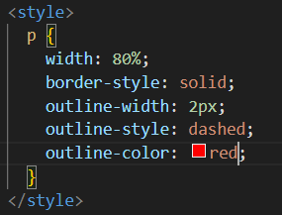
CSS Outline
An outline is a line drawn outside the element's border.
outline-style
outline-color
outline-width
outline-offset
outline

Slide 54
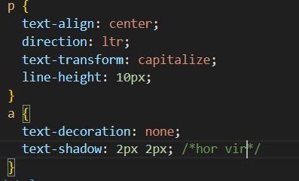
CSS Text

Slide 55
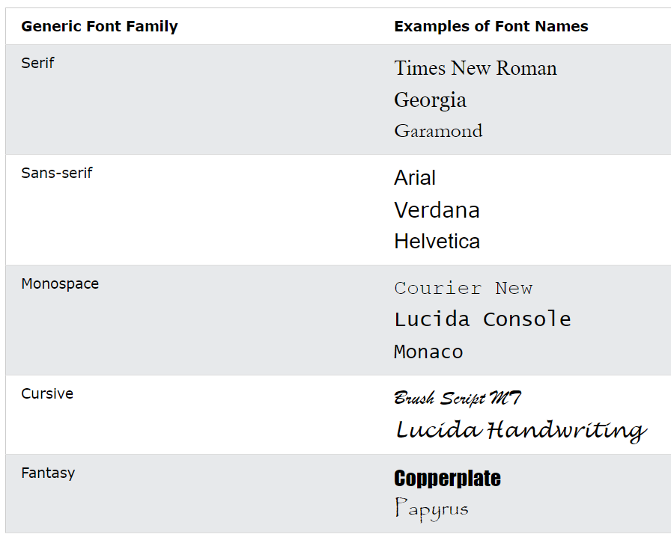
CSS Font
Font-family :
Font-style : (normal - ilatice - oblique)
Font-weight : 900
Font-size : px / em
1em is equal to the current font size. The default text size in browsers is 16px. So, the default size of 1em is 16px.
The size can be calculated from pixels to em using this formula: pixels/16=em

Slide 56
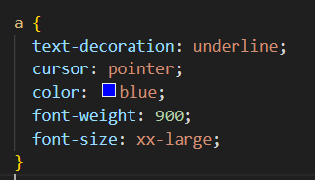
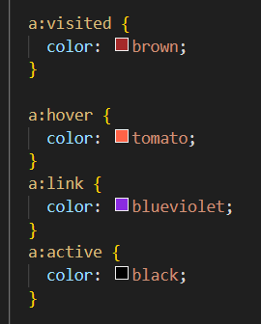
CSS Links
links can be styled differently depending on what state they are in.
The four links states are:
a:link - a normal, unvisited link
a:visited - a link the user has visited
a:hover - a link when the user mouses over it
a:active - a link the moment it is clicked

Slide 57
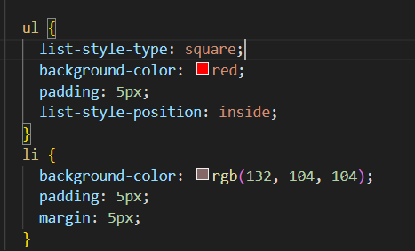
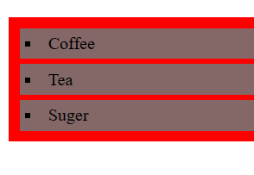
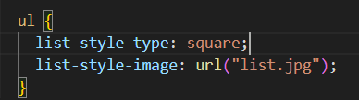
CSS List
The CSS list properties allow you to:
Set different list item markers for ordered lists
Set different list item markers for unordered lists
Set an image as the list item marker
Add background colors to lists and list items

Slide 58
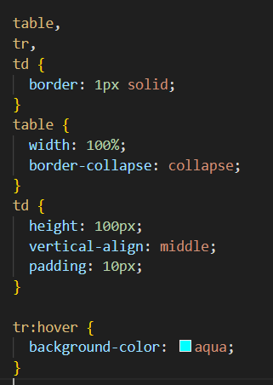
CSS Table
Properties For table , td , tr :
border: 1px solid;
border-collapse: collapse;
Width : 100%
hight:20%
Text-align >> td
Vertical-align >> td

Slide 59
CSS Combinator
A combinator is something that explains the relationship between the selectors.
A CSS selector can contain more than one simple selector. Between the simple selectors, we can include a combinator.
There are four different combinators in CSS:
descendant selector (space)
child selector (>)
adjacent sibling selector (+)
general sibling selector (~)

Slide 60
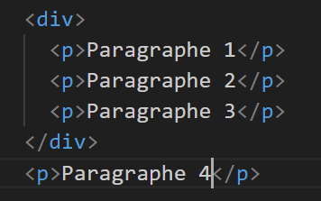
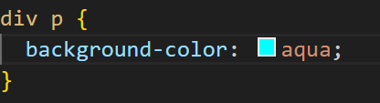
Descendant Selector
The descendant selector matches all elements that are descendants of a specified element

Slide 61
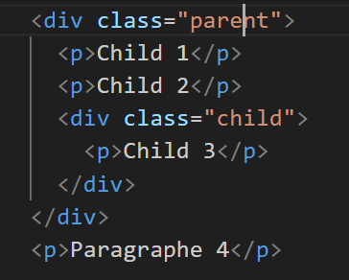
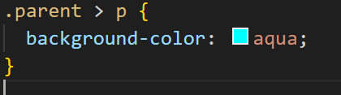
Child Selector
The child selector selects all elements that are the children of a specified element

Slide 62
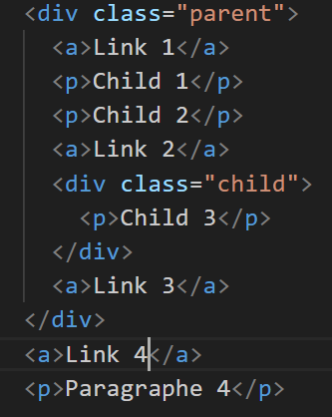
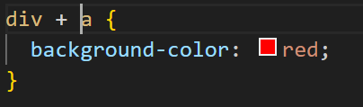
Adjust Sibling Selector
The adjacent sibling selector is used to select an element that is directly after another specific element.
Sibling elements must have the same parent element, and "adjacent" means "immediately following".

Slide 63
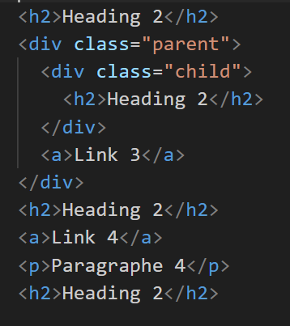
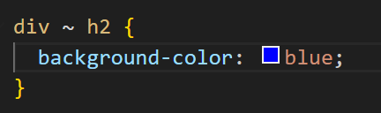
General Sibling Selector
The general sibling selector selects all elements that are next siblings of a specified element.

Slide 64
Task
Add a button to open new page that contains a form to upload new video
This form contains
Title , Description , upload , sharing date ,
This video for kid ? 2 radio button (yes , no )
and submit button
When submit the data , new page with success message opened and when click ok it returns to main page (playlist)

Slide 65
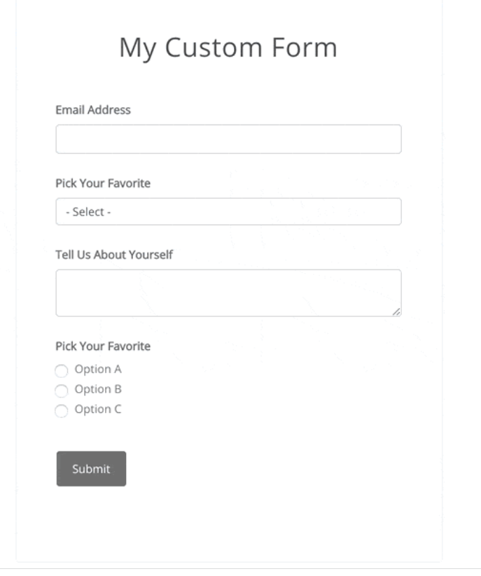

Task

